Slide 1
Improve Sample Efficiency in Multi-agent Reinforcement Learning by Exploration and state representation
①
②
③
QFuture: Learning Future Expectation Cognition in Multiagent Reinforcement Learning
Attentive Relational State Representation in Decentralized Multiagent Reinforcement Learning
Extrinsic-and-Intrinsic Reward-Based Multi-Agent Reinforcement Learning for Multi-UAV Cooperative Target Encirclement
⑤
④
WToE: Learning When to Explore in Multiagent Reinforcement Learning
Neighborhood curiosity-based exploration in multi-agent reinforcement learning
CPS Computational Learning Laboratory
Notes:
通过探索提高多智能体强化学习的样本效率
多智能体变分探索
基于影响的多智能体探索
基于新颖性共享的去中心化多智能体协同探索解决方法
基于种群的稀疏奖励多智能体任务多样性探索
具有好奇心驱动探索的情景多智能体强化学习

Slide 2

①
③
QFuture: Learning Future Expectation Cognition in Multiagent Reinforcement Learning
Extrinsic-and-Intrinsic Reward-Based Multi-Agent Reinforcement Learning for Multi-UAV Cooperative Target Encirclement
State representation learning
Multi-agent cooperate exploration
②
④
⑤
Attentive Relational State Representation in Decentralized Multiagent Reinforcement Learning
Neighborhood curiosity-based exploration in multi-agent reinforcement learning
WToE: Learning When to Explore in Multiagent Reinforcement Learning
Improve sample effiency
CPS Computational Learning Laboratory
Notes:
首先介绍第一篇

Slide 3
Paper 1
QFuture: Learning Future Expectation Cognition in Multiagent Reinforcement Learning
Boyin Liu , Zhiqiang Pu , Member, IEEE, Yi Pan , Jianqiang Yi , Senior Member, IEEE, Min Chen , and Shijie Wang
Publish Journal/Conference: IEEE Transactions on Cognitive and Developmental Systems (TCDS 2024)
CPS Computational Learning Laboratory
Notes:
在多智能体强化学习中学习未来预期认知

Slide 4
01
Problem Description
02
Method Design
03
Experiment Results
Contents
04
Conclusion
CPS Computational Learning Laboratory
Notes:
主要分为以下四个部分

Slide 5
01
Problem Description
02
Method Design
03
Experiment Results
Contents
04
Conclusion
CPS Computational Learning Laboratory
Notes:
主要分为以下四个部分

Slide 6
Problem Description
Challenge:
The agent learning process can be hampered by myopia, wherein agents’ strategies fail to consider the long-term consequences of their actions. A primary reason for this problem is the inaccurate estimation of the long-term value of each action.
Method:
Future expectation cognition module (FECM)
We model future expectation cognition as random variables in FECM, which learn representation by maximizing mutual information with the future trajectory based on current information.
CPS Computational Learning Laboratory
Notes:
智能体学习过程可能会受到短视的阻碍，其中智能体的策略未能考虑其行为的长期后果。这个问题的主要原因是对每个智能体的长期动作价值的不准确估计。
未来期望认知模块（FECM）。在FECM模块中将未来期望认知建模为随机变量，通过最大化当前信息与未来轨迹的互信息来学习未来期望认知的表征。

Slide 7
01
Problem Description
02
Method Design
03
Experiment Results
Contents
04
Conclusion
CPS Computational Learning Laboratory
Notes:
研究现状

Slide 8
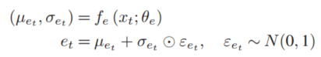
Method Design
Future Expectation Cognition Module FECM
The joint policy π induces a Joint action value function
(1)
The expected discounted return is
(2)
Here, we represent the future expectation cognition at time t (denoted as $e_{t}$) using a multivariate Gaussian distribution $N(μ_{e_{t}},σ_{e_{t}})$, where mean $μ_{e_{t}}$ and variance $σ_{e_{t}}$ represents the expectation and the uncertainty of the future, respectively. Formally, at time t, its future expectation cognition is learned by
(3)
where $x_{t}$ is the input of FECM and $f_{e}$ denotes a trainable neural network parameterized by $θ_{e}$ (future expectation cognition encoder). The sampled future expectation cognition is then fed into the future expectation cognition decoder to further generate the inputs for individual action value or Joint action value.
CPS Computational Learning Laboratory
Notes:
使用多变量高斯分布来建模t时刻的未来期望认知，表示为et，其中均值μet和方差σet分别表示均值和方差。
xt为FECM模块的输入，也就是经过编码器的观测，fe是一个神经网络，et采用重参数化的方法从高斯分布中采样获取

Slide 9
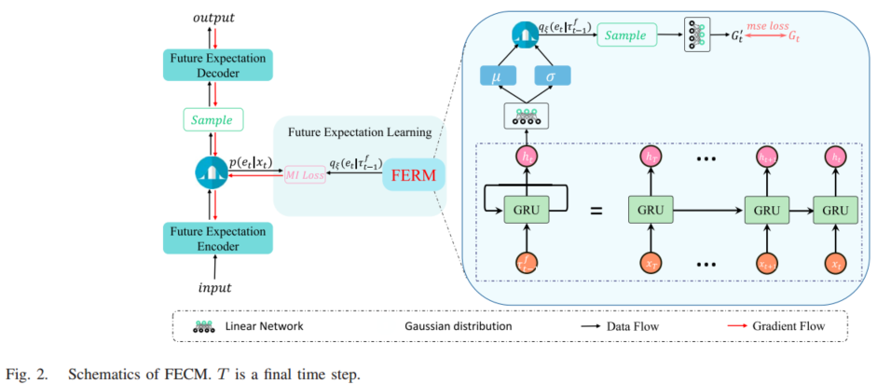
Method Design
CPS Computational Learning Laboratory

Slide 10
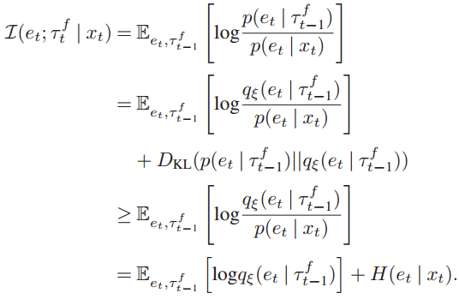
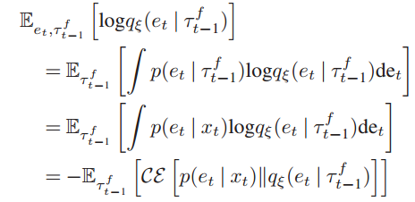
Method Design
Under the CTDE paradigm, the whole episode’s information in an episode is available in the training phase. Therefore, we propose an information-theoretic objective for maximizing the MI $I(e_{t};τ_{t}^{f}|x_{t})$ between future expectation cognition $e_{t}$ and future trajectory $τ_{t}^{f}$ given $x_{t}$, where $τ_{t}^{f}=(x_{t+1},...,x_{T})$ is the future trajectory information at time t.
(4)
(5)
Since the future expectation cognition encoder is conditioned on current information $x_{t}$, the distributions of future expectation cognition ${p(e}_{t})$ are independent of the future trajectory $τ_{t}^{f}$. where CE means cross entropy
CPS Computational Learning Laboratory
Notes:
在CTDE方法的训练阶段，一个回合中的全部step信息都是可用的，提出了一个最大化x的轨迹和后验概率q计算的e之间的互信息
由于et和τ之间的信息熵很难计算，因此引入了一个用ε参数化的后验分布q
由于未来期望认知编码器以当前信息xt为条件，因此p（et）的分布与未来轨迹τ无关

Slide 11
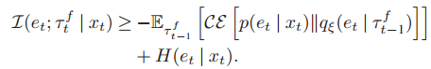
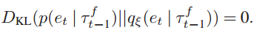
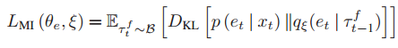
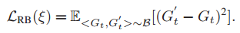
Method Design
(6)
The lower bound matches the exact MI when the following equations hold:
(7)
On this basis, we can derive the following minimization objective:
(8)
The embedding of FERM is sampled from the variational posterior distribution qξ(et | τ ft−1), and then fed into a linear neural network to estimate the expected discounted return and output Gt. The reparameterization trick is applied to ensure the gradient is tractable for the sampling operation. Thus, the loss of FERM is
(9)
CPS Computational Learning Laboratory
Notes:
总结公式(4)和(5)可以得到公式(6)互信息变分下界
当满足公式(7)时，互信息与其下界相等
论文给出了互信息的优化目标
在FECM模块中，FERM的输出是从变分后验分布q中采样然后输入线性层的，线性层的输出为G’以预测折扣期望回报G t。这里采用重参数化技巧得到FERM的损失

Slide 12
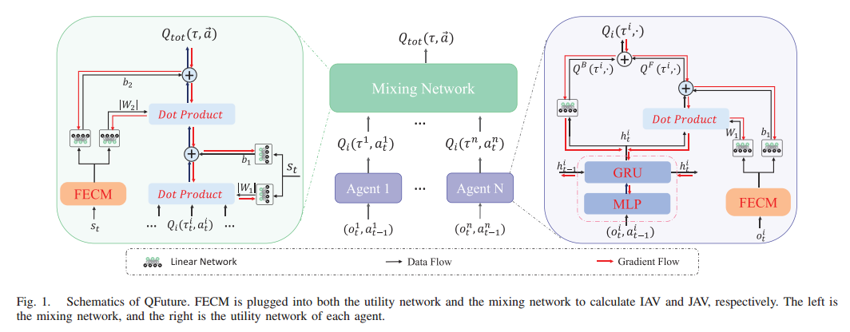
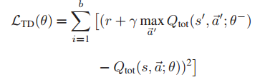
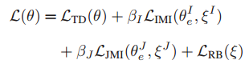
Method Design
The mixing network uses the individual action values of all agents as input and mixes them monotonically, providing the values of $Q_{tot}$ and optimizing the following TD loss:
(10)
(11)
CPS Computational Learning Laboratory

Slide 13
01
Problem Description
02
Method Design
03
Experiment Results
Contents
04
Conclusion
CPS Computational Learning Laboratory

Slide 14
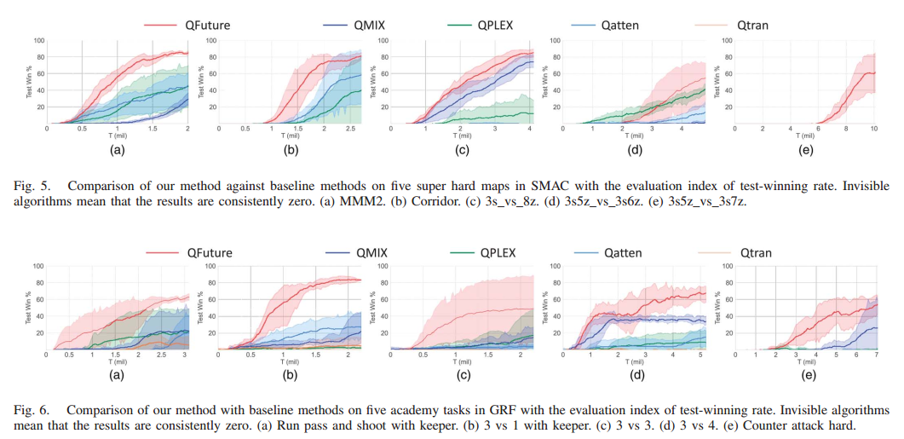
Experiment Results
CPS Computational Learning Laboratory

Slide 15
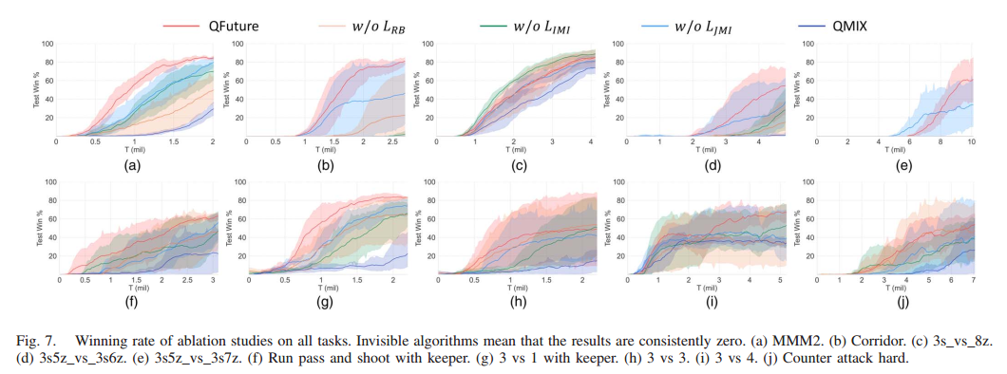
Experiment Results
CPS Computational Learning Laboratory

Slide 16
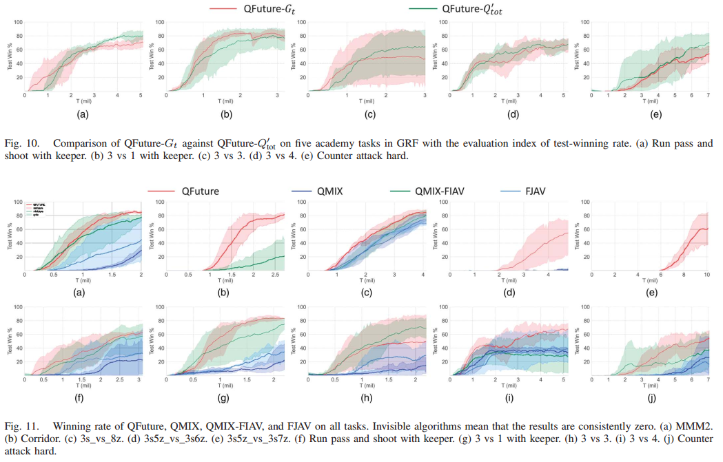
Experiment Results
CPS Computational Learning Laboratory

Slide 17
01
Problem Description
02
Method Design
03
Experiment Results
Contents
04
Conclusion
CPS Computational Learning Laboratory
CPS Computational Learning Laboratory
2
18
Notes:
最后一部分是未来工作

Slide 18
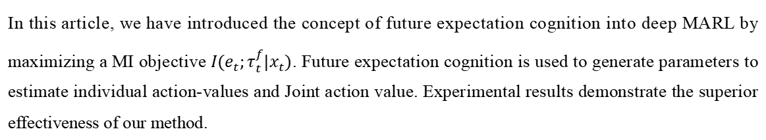
Conclusion
①
In this article, we have introduced the concept of future expectation cognition into deep MARL by maximizing a MI objective $I(e_{t};τ_{t}^{f}|x_{t})$. Future expectation cognition is used to generate parameters to estimate individual action-values and Joint action value. Experimental results demonstrate the superior effectiveness of our method.
②
To our best knowledge, it is the first article using all future steps information at each step’s training in MARL. This utilization can accelerate training and promote collaboration, but it is easily stuck in chronological logical traps.
CPS Computational Learning Laboratory
Notes:
这篇文章通过最大化未来期望认知et和xt的轨迹τft之间的互信息，将未来期望认知的概念引入到多智能体强化学习中
这是第一篇在MARL的每一步训练中使用所有未来步骤信息的文章，这种利用可以加速训练和促进协作，但它的缺点是很容易陷入时序逻辑陷阱。

Slide 19
Paper 2
Attentive Relational State Representation in Decentralized Multiagent Reinforcement Learning
Xiangyu Liu and Ying Tan , Senior Member, IEEE
Publish Journal: IEEE Transactions on Cybernetics (TCYB 2022)
CPS Computational Learning Laboratory
Notes:
去中心化多智能体强化学习中的注意力关系状态表征

Slide 20
01
Problem Description
02
Method Design
03
Experiment Results
Contents
04
Conclusion
CPS Computational Learning Laboratory

Slide 21
01
Problem Description
02
Method Design
03
Experiment Results
Contents
04
Conclusion
CPS Computational Learning Laboratory

Slide 22
Problem Description
In multiagent reinforcement learning (MARL), it is crucial for each agent to model the relation with its neighbors. Existing approaches usually resort to concatenate the features
of multiple neighbors, fixing the size and the identity of the inputs. But these settings are inflexible and unscalable.
We propose an attentive relational encoder (ARE), which is a novel scalable feedforward neural module, to attentionally aggregate an arbitrary-sized neighboring feature set for state
representation in the decentralized MARL.
CPS Computational Learning Laboratory
Notes:
在多智能体强化学习（MARL）中，每个智能体与其邻居的关系建模是至关重要的。现有的方法通常采用连接多个邻居的特征，固定输入的大小和身份，但这些设置不灵活且不可扩展。
这篇文章中提出了一个注意力关系编码器（ARE），在去中心化多智能体强化学习算法中，采用注意力聚合一个任意大小的邻居特征集的状态表征。

Slide 23
01
Problem Description
02
Method Design
03
Experiment Results
Contents
04
Future Work
CPS Computational Learning Laboratory
Notes:
研究现状

Slide 24
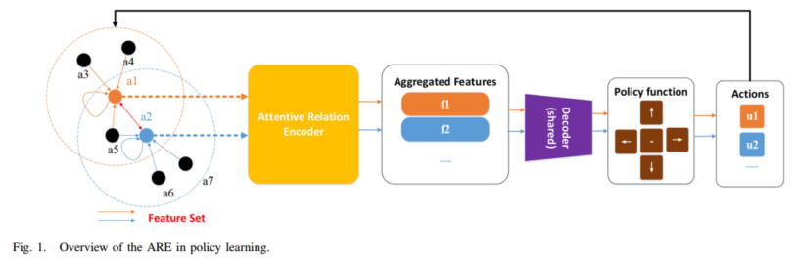
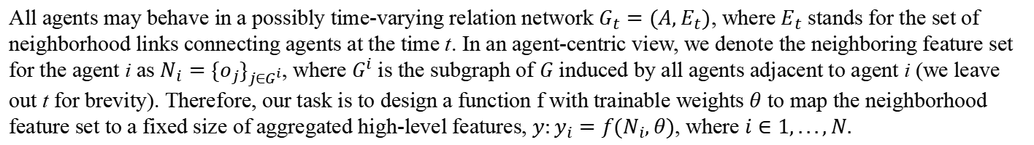
Method Design
All agents may behave in a possibly time-varying relation network $G_{t}=(A,E_{t})$, where $E_{t}$ stands for the set of neighborhood links connecting agents at the time t. In an agent-centric view, we denote the neighboring feature set for the agent i as $N_{i}={\{o_{j}\}}_{j∈G^{i}}$, where $G^{i}$ is the subgraph of $G$ induced by all agents adjacent to agent i (we leave out t for brevity). Therefore, our task is to design a function f with trainable weights $θ$ to map the neighborhood feature set to a fixed size of aggregated high-level features, $y:y_{i}=f(N_{i},θ)$, where $i∈1,...,N.$
CPS Computational Learning Laboratory
Notes:
所有的智能体位于一个时变的图网络Gt上，其中Et代表边集合，A代表智能体集合。采用Ni表示为智能体i的相邻观测特征集。其中Gi是G的子图，Gi由智能体i的所有相邻智能体组成。
这篇文章的目的是设计一个具有可训练权重θ的函数f，将邻域特征集映射到聚合的高级特征的固定大小，也就是yi。这个函数f就是图中黄色部分所示的ARE模块。
然后，这些聚合的特征被馈送到控制策略的共享解码器中，解码器输出的张量输入呆策略网络中生成动作的概率分布，最后采样获得动作。

Slide 25
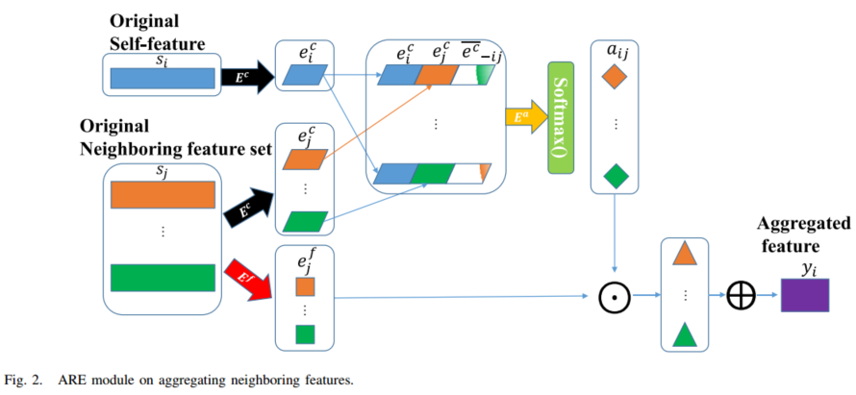
Method Design
CPS Computational Learning Laboratory

Slide 26
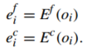
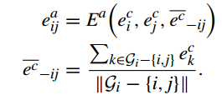
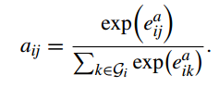
Method Design
First, we obtain two streams of latent vectors, $e_{i}^{f}$ and $e_{i}^{c}$
(1)
Second, ARE computes attention scores using the latent vectors $e^{c}$ for each corresponding neighboring agent through $E^{a}$, taking the self feature $e_{i}^{c}$, the corresponding neighbor’s feature $e_{i}^{c}$, as well as an ME for other neighboring agents in $G^{i}$ other than the agents i and j
(2)
It is worth emphasizing that the self feature is also included in the neighboring feature set in ARE to evaluate the attention score for each agent itself.
Third, the learnt attention activations are normalized across the neighborhood set computing a set of attention weights
${\vec{a}}_{i}={\{a_{ij}\}}_{j∈G^{i}}$. We choose softmax as the normalization operation, so the attention weight for the jth neighboring
(3)
CPS Computational Learning Laboratory
Notes:
ARE使用Ea编码器计算智能体i和智能体j之间的计算注意力分数，输入为智能体i和智能体j经过Ec得到的特征以及除了智能体i和智能体j以外其他智能体通过编码器Ec后的平均值，如公式(2)所示
在ARE中，自我特征也包含在相邻智能体特征集中
学习到的注意力系数在邻域集上进行softmax归一化，因此第j个邻域智能体的注意力权重

Slide 27
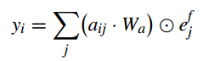
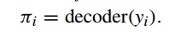
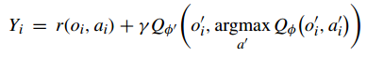
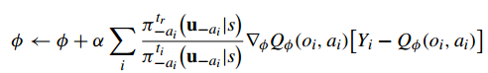
Method Design
Subsequently, the computed attention weights are multiplied by their corresponding intrinsic latent features in ef , generating a new set of deep weighted features. Finally, these weighted features are pooled by summing up across the neighborhood set, producing a fixed size of aggregated features which are then fed into a shared decoder to the downstream control policy
(4)
(5)
(6)
(7)
CPS Computational Learning Laboratory
Notes:
最后，这些加权特征通过在邻域集合上求和而被合并，产生固定大小的聚合特征
然后将所有智能体的特征塞进解码器中，通过策略网络生成每个智能体的策略

Slide 28
01
Problem Description
02
Method Design
03
Experiment Results
Contents
04
Conclusion
CPS Computational Learning Laboratory

Slide 29
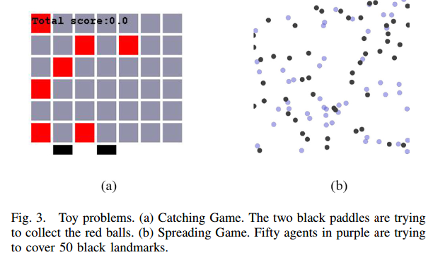
Experiment Results
CPS Computational Learning Laboratory

Slide 30
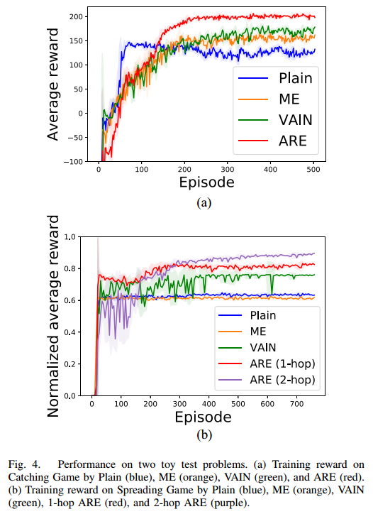
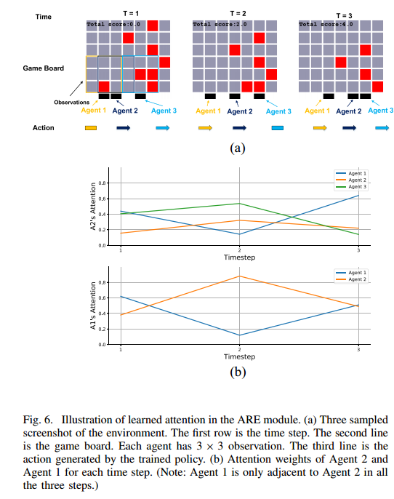
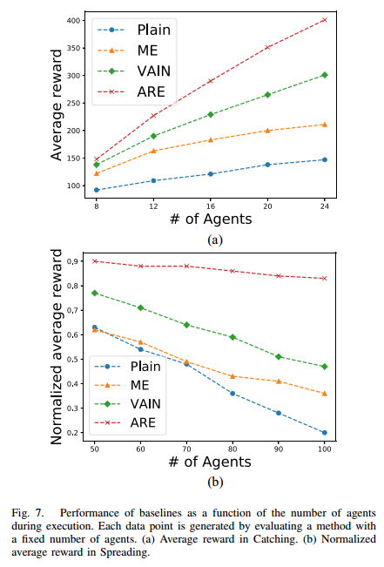
Experiment Results
CPS Computational Learning Laboratory

Slide 31
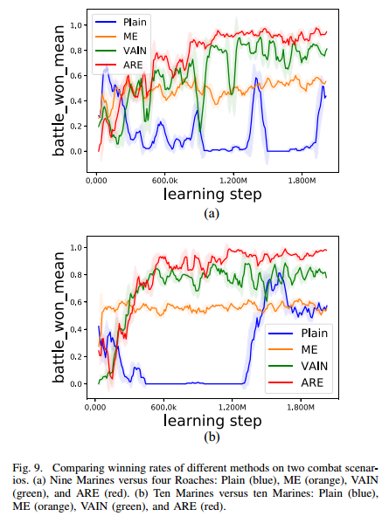
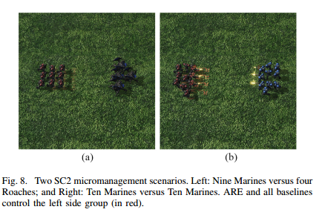
Experiment Results
CPS Computational Learning Laboratory

Slide 32
01
Problem Description
02
Method Design
03
Experiment Results
Contents
04
Conclusion
CPS Computational Learning Laboratory
CPS Computational Learning Laboratory
2
18

Slide 33
Conclusion
①
ARE has been proposed for learning-aggregated state representation in multiagent decentralized learning. ARE is a compact neural-network-based architecture, which efficiently and selectively aggregates information by using an attention mechanism and can be trained end-to-end by reinforcement learning. Unlike the existing methods, it is permutation invariant, computationally efficient, and flexible to the arbitrary number of neighbors in the frequently interactive environment.
②
We hope that this framework could shed some light on the future research of multiagent learning in large-scale scenarios and real-world problems.
CPS Computational Learning Laboratory
Notes:
ARE是一种基于神经网络的结构，它利用注意力机制有选择地聚集邻域信息，通过强化学习进行端到端的训练。与现有方法不同，ARE具有置换不变性、计算效率高、对任意数量的邻居均有效。
作者们希望这个框架可以为未来的大规模多智能体学习研究提供一些启示。

Slide 34
Paper 3
Extrinsic-and-Intrinsic Reward-Based Multi-Agent Reinforcement Learning for Multi-UAV Cooperative Target Encirclement
Jinchao Chen , Member, IEEE, Yang Wang , Ying Zhang , Member, IEEE, Yantao Lu , Member, IEEE, Qiuhao Shu, and Yujiao Hu , Member, IEEE
Publish Journal: IEEE Transactions on Intelligent Transportation Systems (TITS 2025)
CPS Computational Learning Laboratory
Notes:
用于多无人机协同目标围剿的基于内在和外在奖励的多智能体强化学习

Slide 35
01
Problem Description
02
Method Design
03
Experiment Results
Contents
04
Conclusion
CPS Computational Learning Laboratory
Notes:
问题描述，研究现状，方法设计，实验结果，未来工作

Slide 36
01
Problem Description
02
Method Design
03
Experiment Results
Contents
04
Conclusion
CPS Computational Learning Laboratory
Notes:
问题描述，研究现状，方法设计，实验结果，未来工作

Slide 37
Problem Description
In the practical applications of heterogeneous UAVs, it is often difficult to provide stable and effective rewards to continuously improve the policies and guide the learning steps. Especially in the scenario of multi-UAV cooperative target encirclements, the reinforcement signals of each agent are very sparse and cannot be exactly provided by fully evaluating the behaviors of each individual UAV in every step. This may lead to a slow learning problem or even make learning impossible.
Inspired by the humans’ learning experience that curiosity provides a powerful motivator for humans to explore, discover, and acquire new knowledge, we propose an extrinsic-and-intrinsic reward-based multi-agent reinforcement learning approach to cooperatively control the behaviors of UAVs and achieve the target encirclement missions.
CPS Computational Learning Laboratory
Notes:
在异构无人机的实际应用中，往往难以提供稳定有效的奖励来不断完善策略和指导学习步骤。特别是在多无人机协同包围目标的情况下，由于每个智能体的强化信号非常稀疏，无法通过对每个无人机在每一步的行为进行全面评估来准确地提供，这可能导致学习速度缓慢甚至无法学习。
这篇文章受人类学习经验中好奇心为人类探索、发现和获取新知识提供强大动力的启发，提出了一种基于外在和内在奖励的多智能体强化学习方法来协同控制无人机的行为，实现目标包围任务。

Slide 38
01
Problem Description
02
Method Design
03
Experiment Results
Contents
04
Conclusion
CPS Computational Learning Laboratory
Notes:
研究现状

Slide 39
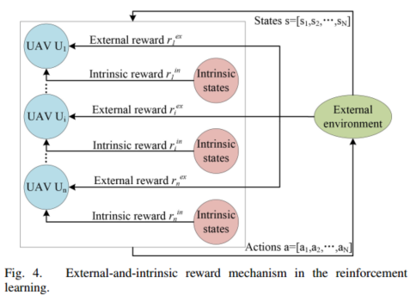
Method Design
Extrinsic-and-Intrinsic Reward Mechanism
CPS Computational Learning Laboratory

Slide 40
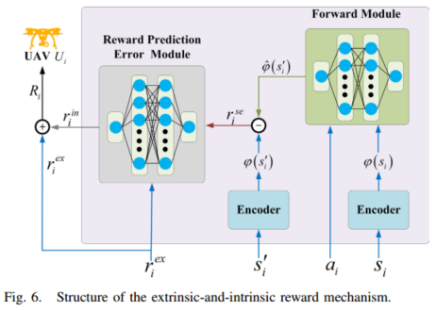
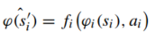
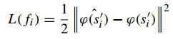
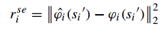
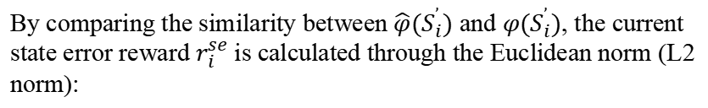
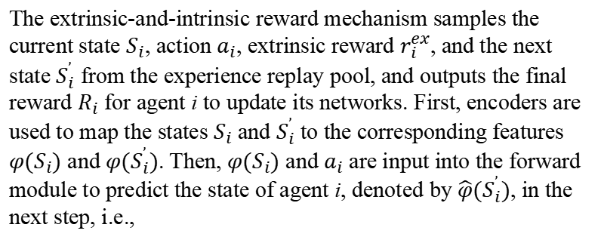
Method Design
The extrinsic-and-intrinsic reward mechanism samples the current state $S_{i}$, action $a_{i}$, extrinsic reward $r_{i}^{ex}$, and the next state $S_{i}^{’}$ from the experience replay pool, and outputs the final reward $R_{i}$ for agent i to update its networks. First, encoders are used to map the states $S_{i}$ and $S_{i}^{’}$ to the corresponding features $φ(S_{i})$ and $φ(S_{i}^{’})$. Then, $φ(S_{i})$ and $a_{i}$ are input into the forward module to predict the state of agent i, denoted by $\hat{φ}(S_{i}^{’})$, in the next step, i.e.,
(1)
Minimizing the difference between the features $\hat{φ}(S_{i}^{’})$ and $φ(S_{i}^{’})$.
(2)
By comparing the similarity between $\hat{φ}(S_{i}^{’})$ and $φ(S_{i}^{’})$, the current state error reward $r_{i}^{se}$ is calculated through the Euclidean norm (L2 norm):
(3)
CPS Computational Learning Laboratory
Notes:
si为每个智能体状态、ai为每个智能体动作、rexi为每个智能体的外在奖励，s′i为每一个智能体下一时刻状态。
首先，采用2个编码器，输入为当前和下一时刻状态，得到$φ(S_{i})$和$φ(S_{i}^{’})$，然后将$φ(S_{i})$输入到前向模块中，得到$\hat{φ}(S_{i}^{’})$。
作者希望最小化$\hat{φ}(S_{i}^{’})$和$φ(S_{i}^{’})之间的差异$，采用公式(2)所示的损失训练f网络。然后将$\hat{φ}(S_{i}^{’})$和$φ(S_{i}^{’})$之间的蒸馏误差作为未经处理的内在奖励

Slide 41
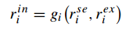
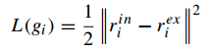
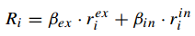
Method Design
Subsequently, the reward prediction error module outputs the intrinsic reward $r_{i}^{in}$ by taking the external reward $r_{i}^{ex}$ and the state error reward $r_{i}^{se}$ as input:
(4)
Since the optimization objective of the reward prediction error module is to minimize the error between the external reward $r_{i}^{ex}$ and the intrinsic reward $r_{i}^{in}$, the loss function of $g_{i}$ can be expressed as:
(5)
the loss function of the extrinsic-and-intrinsic reward mechanism can be stated as:
(6)
the reward Ri for agent i can be obtained by weighted summing the intrinsic reward $r_{i}^{in}$ and the external reward $r_{i}^{ex}$
(7)
CPS Computational Learning Laboratory
Notes:
将外部奖励rexi和状态误差奖励rse输入到奖励预测误差模块，得到内在奖励
这篇文章说奖励预测误差模块的优化目标是最小化外部奖励r ex i和内在奖励r in i之间的误差，公式(5)是gi的损失函数

Slide 42
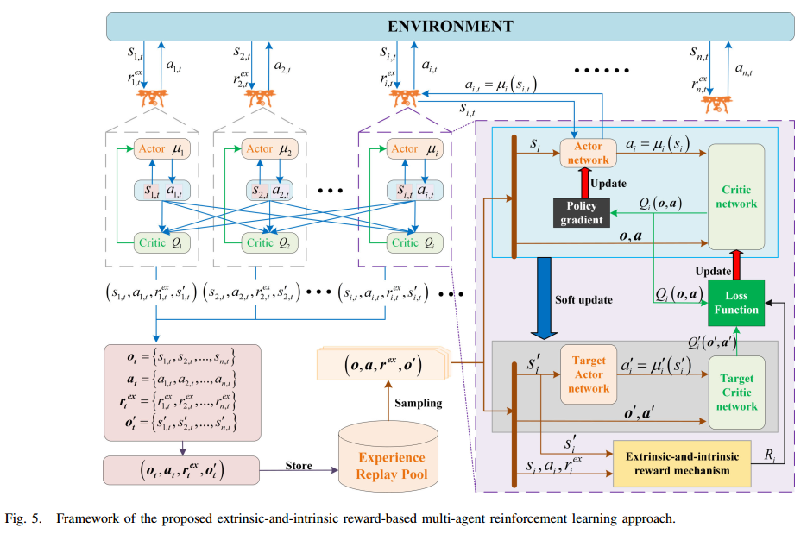
Method Design
CPS Computational Learning Laboratory

Slide 43
01
Problem Description
02
Method Design
03
Experiment Results
Contents
04
Conclusion
CPS Computational Learning Laboratory

Slide 44
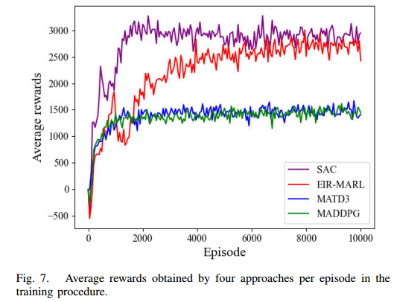
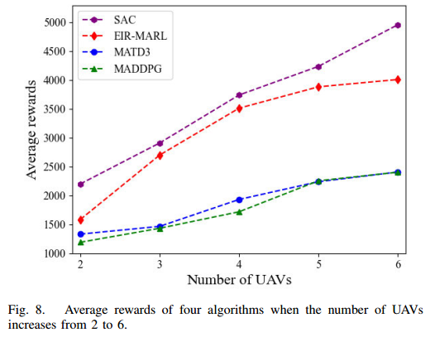
Experiment Results
CPS Computational Learning Laboratory

Slide 45
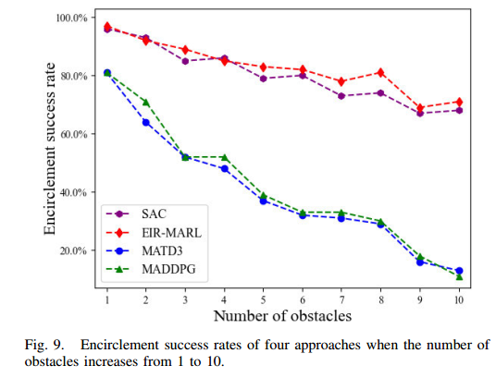
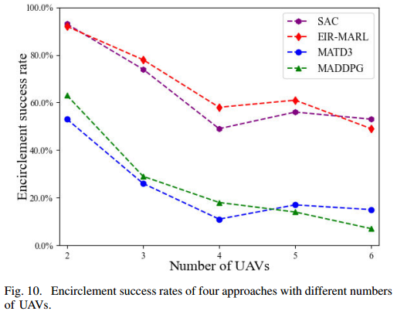
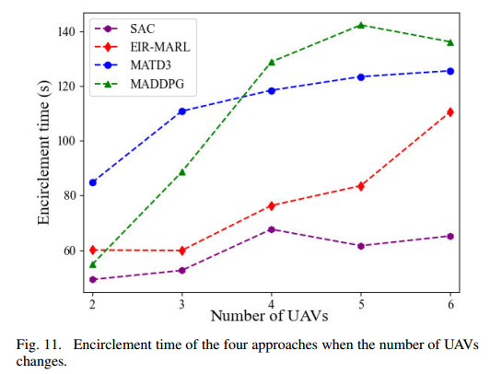
Experiment Results
CPS Computational Learning Laboratory

Slide 46
01
Problem Description
02
Method Design
03
Experiment Results
Contents
04
Conclusion
CPS Computational Learning Laboratory
CPS Computational Learning Laboratory
2
18

Slide 47
Conclusion
①
This paper focuses on the cooperative target encirclement problem of heterogeneous UAVs and proposes a multi-agent reinforcement learning approach to provide optimal encirclement strategies. An extrinsic-and-intrinsic reward-based multi-agent reinforcement learning framework is proposed to seek an optimal and safe path for each UAV from the starting position to the target encirclement point, efficiently solving under-exploration and poor convergence problems of traditional reinforcement learning algorithms.
②
Although our approach can obtain a reasonable solution to solve the target encirclement problem, it still suffers from the space explosion problem when the number of UAVs and obstacles sharply increases.
CPS Computational Learning Laboratory
Notes:
这篇文章针对异构无人机协同目标包围问题，设计了一种基于内在和外在奖励的多智能体强化学习框架，为每架无人机寻找一条从起始位置到目标包围点的最优安全路径，有效地解决了传统强化学习算法存在的探索不足和收敛性差的问题。
这篇文章的缺陷在于，当无人机和障碍物的数量急剧增加时，仍会受到维度灾难的影响。

Slide 48
Paper 4
Neighborhood curiosity-based exploration in multi-agent reinforcement learning
Shike Yang, Ziming He , Jingchen Li , Haobin Shi∗, Qingbing Ji∗, Kao-Shing Hwang Senior Member, IEEE and Xianshan Li
Publish Journal: IEEE Transactions on Cognitive and Developmental Systems (TCDS-2021)
CPS Computational Learning Laboratory
Notes:
多智能体强化学习中基于邻域好奇心的探索

Slide 49
01
Problem Description
02
Method Design
03
Experiment Results
Contents
04
Conclusion
CPS Computational Learning Laboratory
Notes:
问题描述，研究现状，方法设计，实验结果，未来工作

Slide 50
01
Problem Description
02
Method Design
03
Experiment Results
Contents
04
Conclusion
CPS Computational Learning Laboratory
Notes:
问题描述，研究现状，方法设计，实验结果，未来工作

Slide 51
Problem Description
Efficient exploration in cooperative multi-agent reinforcement learning is still tricky in complex tasks.
In this paper, we propose a novel multi-agent collaborative exploration method called Neighborhood Curiosity-based Exploration (NCE), by which agents can explore not only novel states but also new partnerships. Concretely, we use the attention mechanism in graph convolutional networks to perform a weighted summation of features from neighbors. The calculated attention weights can be regarded as an embodiment of the relationship among agents. Then we use the prediction errors of the aggregated features as intrinsic rewards to facilitate exploration.
CPS Computational Learning Laboratory
Notes:
在复杂任务中，协同多智能体强化学习的有效探索仍然是困难的。
这篇文章提出了一种基于邻域好奇心的探索（NCE），利用图卷积网络中的注意力机制对邻居的特征进行加权求和，计算出的注意力权重可以体现智能体之间的关系。然后，使用聚合特征的蒸馏误差作为内在奖励，以促进探索。

Slide 52
01
Problem Description
02
Method Design
03
Experiment Results
Contents
04
Conclusion
CPS Computational Learning Laboratory
Notes:
研究现状

Slide 53
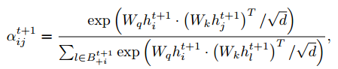
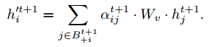
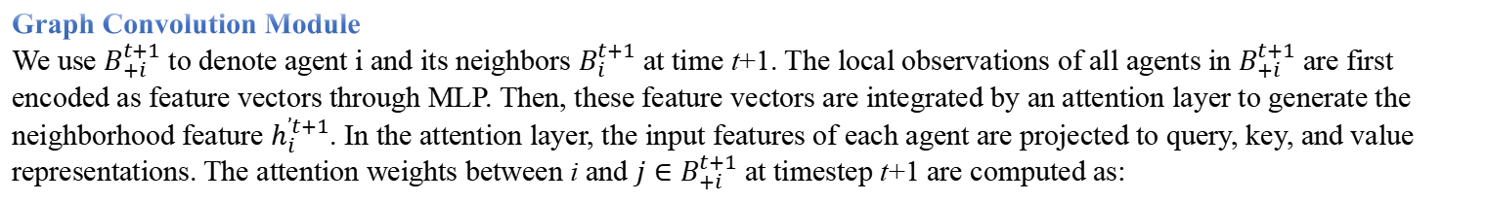
Method Design
Assuming that the global observations at time t+1 are represented by $o^{t+1}=[o_{1}^{t+1},...,o_{N}^{t+1}]$, the neighbors of i are $B_{i}^{t+1}=\{1,...,k\}$, and the adjacency matrix of i are $M_{i}^{t+1}$.
Graph Convolution Module
We use $B_{+i}^{t+1}$ to denote agent i and its neighbors $B_{i}^{t+1}$ at time t+1. The local observations of all agents in $B_{+i}^{t+1}$ are first encoded as feature vectors through MLP. Then, these feature vectors are integrated by an attention layer to generate the neighborhood feature $h_{i}^{’t+1}$. In the attention layer, the input features of each agent are projected to query, key, and value representations. The attention weights between i and ${j∈B}_{+i}^{t+1}$ at timestep t+1 are computed as:
(1)
where d is a normalization factor that scales the result. Attention weights reflect cooperative relationships among agents—the bigger the attention weights, the closer the agents’ collaboration. Then the value representations of all input features are weighted by the attention weights and summed together to generate the aggregated neighborhood feature of agent i:
(2)
CPS Computational Learning Laboratory
Notes:
采用B+i表示智能体i自己和邻居Bi的集合，首先将B+i中所有智能体的局部观测值通过MLP编码为特征向量hi，然后计算这些特征向量的注意力系数，公式(1)所示
利用公式(2)聚合邻居节点的特征，得到智能体i聚合后的特征h ′i，如公式(2)所示。

Slide 54




Method Design
RND Module
We use $φ(h_{i}^{’t+1})$ and $ψ(h_{i}^{’t+1})$ to denote the neighborhood features generated by the prediction network and the target network, respectively. Then a distance function is used to calculate the distance between $φ(h_{i}^{’t+1})$ and $ψ(h_{i}^{’t+1})$, e.g., the L2 distance. After calculating the intrinsic rewards ${[r_{i}^{int}]}_{i=1}^{N}$ for all agents separately, take their sum as the total intrinsic reward. That is, the intrinsic reward at time t is generated by the following formula:
(3)
Calculating the intrinsic reward in this way may cause agents to change cooperative relationships frequently to get more intrinsic rewards, so it is necessary to add temporal relation regularization to make agents maintain stable cooperative relationships in a short time. Specifically, the KL divergence of the attention weight distribution of agent i at timestep t and timestep t + 1 (represented by $G(O_{B_{+i}}^{t})$ and $G(O_{B_{+i}}^{t+1})$, respectively) is used as the regularization term of the loss function.
(4)
CPS Computational Learning Laboratory
Notes:
用图神经网络作为预测网络的一部分，邻域内智能体动态变化会使智能体频繁地改变协同关系，获得的内在奖励不准确。因为如果智能体邻居变了，那么联合观测空间肯定发生变化，就算智能体当前时刻观测和之前已经遇到了，但是联合状态空间的变化导致仍能产生很大的内在奖励。
这篇文章给出的解决方法是在损失函数中添加正则化以使agent在短时间内保持稳定的合作关系，如公式(4)所示，其中G Ot B+i和G O t+1表示分别表示t时刻和t+1时刻注意力系数的分布，这俩的KL三度被用作损失函数的正则化项。

Slide 55

Method Design
CPS Computational Learning Laboratory

Slide 56
01
Problem Description
02
Method Design
03
Experiment Results
Contents
04
Conclusion
CPS Computational Learning Laboratory

Slide 57

Experiment Results
CPS Computational Learning Laboratory

Slide 58


Experiment Results
CPS Computational Learning Laboratory
Notes:
在星际争霸和谷歌足球中的实验

Slide 59
01
Problem Description
02
Method Design
03
Experiment Results
Contents
04
Conclusion
CPS Computational Learning Laboratory
CPS Computational Learning Laboratory
2
18

Slide 60
Conclusion
①
This paper proposes NCE, an efficient multi-agent collaborative exploration method that can be applied to almost all the existing multi-agent value decomposition methods. By considering the neighboring agents’ relationships when exploring with curiosity, NCE can promote agents to explore novel states and new cooperative relationships.
②
In the future, we consider combining representation learning with NCE to improve its performance, i.e., using a representation learning module instead of a simple MLP to extract features from each agent before aggregating neighborhood features and calculating intrinsic rewards.
CPS Computational Learning Laboratory
Notes:
这篇文章提出了邻域好奇心驱动探索方法，作者还强调了它是一个通用的模块，几乎可以与任意基于值函数的多智能体强化学习算法结合。通过考虑聚合邻居智能体的信息，并利用RND计算好奇心，从而促进智能体探索新的状态和新的合作关系。
未来作者希望采用表征学习的方法代替MLP来提取特征

Slide 61
Paper 5
WToE: Learning When to Explore in Multiagent Reinforcement Learning
Shaokang Dong , Hangyu Mao , Shangdong Yang, Shengyu Zhu , Wenbin Li , Jianye Hao , Member, IEEE, and Yang Gao , Senior Member, IEEE
Publish Journal: IEEE Transactions on Cybernetics (TCYB 2024)
CPS Computational Learning Laboratory
Notes:
学习何时在多智能体强化学习中探索

Slide 62
01
Problem Description
02
Method Design
03
Experiment Results
Contents
04
Conclusion
CPS Computational Learning Laboratory
Notes:
问题描述，研究现状，方法设计，实验结果，未来工作

Slide 63
01
Problem Description
02
Method Design
03
Experiment Results
Contents
04
Conclusion
CPS Computational Learning Laboratory
Notes:
问题描述，研究现状，方法设计，实验结果，未来工作

Slide 64
Problem Description
Existing multiagent exploration works focus on how to explore in the fully cooperative task, which is insufficient in the environment with nonstationarity induced by agent interactions.
we propose When to Explore (WToE), a simple yet effective variational exploration method to learn WToE under nonstationary environments. WToE employs an interaction-oriented adaptive exploration mechanism to adapt to environmental changes. We propose a novel graphical model that uses a latent random variable to model the steplevel environmental change resulting from interaction effects.
CPS Computational Learning Laboratory
Notes:
这篇文章主要解决的问题是探索过程中智能体之间交互引起的环境非平稳性问题
这篇文章提出了一种When to Explore（WToE），采用面向交互的自适应探索机制来适应环境变化，并引入了一种新的图形模型，该模型使用隐随机变量来模拟交互效应引起的阶跃环境变化.

Slide 65





Problem Description
Graphical Model (preliminaries)
The optimality variable is represented as a binary random variable, where $O_{t}=1$ indicates that the action at adheres to the optimal policy at time step t, and otherwise at is nonoptimal. Therefore, the probability of the optimality variable corresponding to the fundamental MDP element ($r∈[−1,0]$) is defined as
(1)
In this model, the probability of observing a given trajectory $τ$ under the optimal policy is as follows:
(2)
Moreover, the probability of observing the same trajectory $τ$ under the learning policy $π(a_{t}|s_{t})$ is
(3)
CPS Computational Learning Laboratory
Notes:
最优变量Ot被表示为二元随机变量，当Ot = 1表示在t时刻的动作at是当前的最后策略，否则at是非最优的。这篇文章把最优变量对应于当前动作状态对的概率定义为公式(1)所示。
在学习到最优策略的情况下采集到轨迹τ的概率定义为公式(2)。
学习到的任意策略pi同样采集到轨迹τ的概率定义为公式(3)。

Slide 66

Problem Description
Minimizing the KL divergence $D_{KL}(\hat{p}(τ)||p(τ))$ of the probability under learning policy $π(a_{t}|s_{t})$ and optimal policy can help the learning policy converge to the optimal policy. Therefore, the learning objective is to maximize
(4)
CPS Computational Learning Laboratory
Notes:
最小化学习策略π采集到轨迹$τ$的概率和最优策略采集到轨迹$τ$的概率之间的KL散度，帮助所学习的策略逼近最优策略，优化目标如公式(4)所示。

Slide 67





Problem Description
The third model is introduced to deal with the between-episode nonstationary problem. It regards each episode as an instance of a stationary MDP, while different episodes are considered as different tasks parameterized by the latent variables $z^{i}$. Within this formulation, the joint probability distribution of trajectories gathered from M episodes with latent variables is defined as
(5)
In each episode, given the latent variable z, the prior probability of each trajectory τ is
(6)
The learning objective under the latent variable z is to maximize
(7)
CPS Computational Learning Laboratory
Notes:
这个模型被引入来处理回合间的非平稳问题，每个框内都是一个马尔可夫决策过程，不同框代表不同回合的任务，这篇文章采用一个隐变量zi来参数化不同回合任务。
假设有M个训练回合，这篇文章定义了算法在M个回合中收集的数据轨迹的联合概率分布，如公式(5)所示。
接下来，这篇文章定义了每回合采集的数据轨迹的先验概率，如公式(6)所示，这个公式是基于公式(2)推导的，加上了给定潜在变量的条件。

Slide 68


Problem Description
Variational Inference (preliminaries)
Variational inference is a valuable and tractable method for approximating the posterior $p(θ|D)$ pertaining to a dataset $D$. Specifically, the posterior can be estimated using an alternative distribution $q(θ;φ)$, parameterized by $φ$, by minimizing the KL divergence $D_{KL}[q(θ;φ)||p(θ|D)]$. As in prior works, it is often more convenient to maximize the evidence lower bound (ELBO) as follows:
(8)
The variational ELBO for $O_{1:T}=1$ is given by
(9)
CPS Computational Learning Laboratory
Notes:
这篇文章还采用变分推断来逼近逼近后验分布p，θ是actor网络的参数，D是replay buffer里的数据。采用一个由φ参数化的先验分布q，通过最小化p和q这两个分布之间的KL散度，来估计后验分布p。这里定义了一个最大化证据下限（ELBO），公式(8)所示。
这篇文章给出了一个回合所有step均学得最优策略的对数概率的证据下界，如公式(9)所示。

Slide 69


Problem Description
The ELBO objective can be decomposed into two components $logp(τ^{1:i−1})$+$logp({O_{1:T}^{i}=1|τ}^{1:i−1})$. Variational inference is used to approximate the distribution $q(z^{i}|τ^{i})$. Therefore, the variational lower bound of the first term can be expressed as follows:
(10)
(11)
CPS Computational Learning Laboratory
Notes:
ELBO目标可以被分解为两个分量，如红色加粗部分所示，第一项的变分下界如公式(10)所示，第二项如公式(11)所示。

Slide 70
01
Problem Description
02
Method Design
03
Experiment Results
Contents
04
Future Work
CPS Computational Learning Laboratory
Notes:
研究现状

Slide 71



Method Design
Dynamic Graphical Model
In the multiagent setting, the environmental change caused by agent interactions plays a pivotal role in shaping adaptive exploration mechanisms. Therefore, it is necessary to incorporate a between-step dynamic graphical model that represents the interaction effect, as depicted in Fig. 3. The latent random variable $z$ is used to model the environmental change caused by agent interactions. Specifically, $z_{t}^{k}$ represents the interaction effect on agent k at time step t.
Optimal Policy
Based on our defined dynamic graphical model, the probability of a trajectory $τ$ given latent variable $z$ for each agent can be represented as
(12)
CPS Computational Learning Laboratory
Notes:
在多智能体环境中，由智能体交互引起的环境变化在形成自适应探索机制中起着关键作用。这篇文章基于上述的图c设计了一个图模型，如图3所示。隐随机变量z用于模拟由智能体交互引起的环境变化。zkt表示t时刻智能体k的交互对环境产生的影响。
最优策略采集的轨迹τ的概率定义为公式(12)，这个其实就是之前的公式(6)

Slide 72




Method Design
The goal is to fit the policy $π(a_{t}|s_{t},z_{t})$ such that the trajectory distribution
(13)
Therefore, the optimization objective is to maximize
(14)
The objective is similar to the maximum entropy reinforcement learning methods, leading to the theoretical derivation of the optimal policy $π(a|s,z)$. This optimal policy considers the influence of z to effectively model the nonstationary environment at the step level, thereby mitigating the nonstationary issue.
CPS Computational Learning Laboratory
Notes:
和之前同样的，定义当前时刻学习到的策略pi采集到最优轨迹的概率，如公式(13)所示，这个其实和前面的公式(3)没有区别。
同样的，优化目标是最小化两个分布之间的KL散度，目的是未来尽可能将当前时刻的策略p逼近最优策略，这个和前面的公式(7)没有区别
这篇论文也解释了为什么所提方法能够解决非平稳问题，说的是最优策略考虑了z的影响，z就是用来衡量智能体对环境影响的隐变量，该方法能够在step级别对非平稳环境进行建模，从而减轻非平稳问题。

Slide 73





Method Design
Learning the Short-Term Inferred Policy
We utilize the VAE framework to approximate the distribution of the latent variable $z$ and the short-term policy $p(a|o,r,z)$. The predicted action $\hat{a}$ is sampled from $p(a|o,r,z)$, and subsequently compared with the actual action sampled from the actor policy $π(a|o)$ to facilitate the training of the VAE.
At time step t, the objective of our VAE model is to maximize the log-likelihood function concerning the predicted action ${\hat{ a}}_{t}$, denoted as $E_{{\hat{ a}}_{t}∈{\hat{ τ}}_{t}}[logp({\hat{a}}_{t}^{k}|o_{t}^{k},r_{t}^{k})]$. To optimize this objective, we aim to maximize its ELBO with a learned posterior distribution $q_{φ}(z|o,r)$. For each agent k, the variational ELBO at time step t is calculated as follows:
(15)
CPS Computational Learning Laboratory
Notes:
这篇文章采用变分自编码器VAE框架来生成从短期策略p（aorz）中采集的动作ahat，并与从actor网络中生成的策略π中采集的真实动作分布进行比较，以此来训练VAE。VAE的架构如图4所示，在t时刻，将每个智能体当前的观测、奖励以及上一时刻的动作和下一时刻的观测输入到编码器中，编码器采用RNN，那么这个输入其实还包括上一时刻的隐藏状态，所以这篇文章说了个past trajectories。编码器的参数为phi，输出为后验分布，在这个分布里采样得到隐变量z。然后将z、t时刻的观测和奖励以及t+1时刻的观测输入到解码器中，输出预测的动作ahat。
这篇文章通过最大化ahat的对数概率来训练VAE模块，如公式(15)所示，最后的结果正好为负的证据下界。

Slide 74




Method Design
When to Explore
The exploration intensity of WToE is proportional to the discrepancy between the actor policy $π(a|o)$ and short-term inferred policy $p(a|o,r,z)$.
We introduce a Gaussian noise $N(0,|{\hat{a}}_{t}^{k}−a_{t}^{k}|)$ with a variance equal to the discrepancy between the actions (step 8, Algorithm 1). Besides that, the critic’s objective for agent k is
(16)
(17)
CPS Computational Learning Laboratory
Notes:
这篇文章在最后对何时去探索进行描述，说的是算法的探索强度和actor网络策略pi和短期推断策略p的差异成正比，也就是说差异大的时候，算法就会开始进行探索。
这篇文章在最终动作确定的时候引入了一个均值为0，方差为两个动作之间差异的高斯噪声，在伪代码的第8步。这篇文章给出的解释是最终决策考虑了actor网络的输出和VAE预测之间的差异，但是他没说这样做有什么优点。
critic网络的优化目标如公式(16)所示。actor网络的优化目标如公式(17)所示。

Slide 75
01
Problem Description
02
Method Design
03
Experiment Results
Contents
04
Conclusion
CPS Computational Learning Laboratory

Slide 76


Experiment Results
CPS Computational Learning Laboratory

Slide 77

Experiment Results
CPS Computational Learning Laboratory

Slide 78
01
Problem Description
02
Method Design
03
Experiment Results
Contents
04
Conclusion
CPS Computational Learning Laboratory
CPS Computational Learning Laboratory
2
18

Slide 79
Conclusion
①
Curiosity-Driven Exploration: The introduction of a curiosity-driven exploration method that utilizes prediction errors of individual Q-values as intrinsic rewards, enabling more effective and coordinated exploration in multi-agent environments.
②
Episodic Memory Integration: The incorporation of episodic memory to store and utilize high-reward experiences, which enhances training efficiency and addresses the challenges posed by the exponential growth of the state space in complex tasks.
③
Future Directions: The limitation of our work lies in the lack of adaptive exploration methods to ensure robustness. Besides, the episodic memory may get problems in stochastic settings.
CPS Computational Learning Laboratory
Notes:
基于好奇心的探索：提出了一种好奇心驱动的探索方法，利用个体Q值的预测误差作为内在奖励，从而在多智能体环境中实现更有效的协调探索。
情节记忆的整合：结合情节记忆来存储和利用高奖励的经验，提升训练效率，并解决复杂任务中状态空间指数增长带来的挑战。
这篇文章的局限性在于缺乏自适应的探索方法来保证鲁棒性。此外，情景记忆在随机环境中也可能出现问题。在今后的工作中，我们可以在这些方向上进行进一步的研究。

Slide 80
Research Inspiration
Decentralized networked multi-agent systems can be combined with cooperative exploration. Additionally, minimizing the KL divergence between the probabilities of the current policy and the optimal policy collecting the same trajectory can be used to approximate the optimal policy.
CPS Computational Learning Laboratory
Notes:
第一篇论文提供了一种最大化当前状态和未来状态之间的互信息的研究思路。
第二篇论文提供了一种不用图神经网络的可扩展信息聚合方案。
第四篇论文将图神经网络与RND结合，可以实现网络化多智能体系统协同探索。
第五篇论文提供了一种最优策略逼近证明思路，最小化两种策略采集到相同轨迹的KL散度。

Slide 81
Thank you for listening
CPS Computational Learning Laboratory
108
Notes:
感谢老师同学观看，请各位老师同学批评指正

